Slide 1
The Swift parallel scripting language for
Science Clouds and other parallel resources
Michael Wilde
Computation Institute, University of Chicago and Argonne National Laboratory
wilde@mcs.anl.gov
Revised 2012.0229
www.ci.uchicago.edu/swift

Slide 2
Context
You’ve heard this afternoon how to run Science work in Clouds
But further challenges need to be addressed:
Running applications with data dependencies that require complex pipelines
Moving data fast and automatically
Dynamically changing size of provisioned resource pools
Handling failures of nodes, networks, application stacks

Slide 3
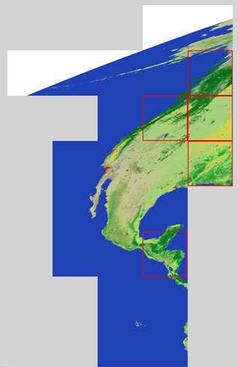
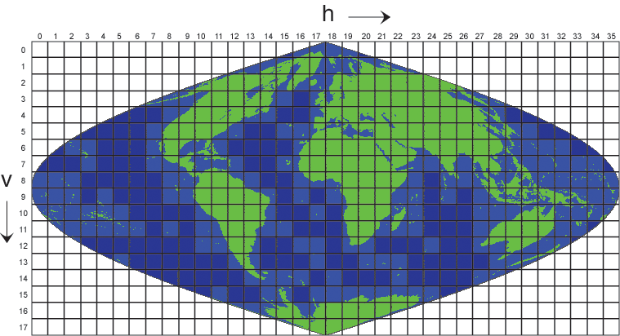
Example – MODIS satellite image processing
Input: tiles of earth land cover (forest, ice, water, urban, etc)
Ouput: regions with maximal specific land types
MODIS
dataset
MODIS analysis script
5 largest forest land-cover tiles in processed region

Slide 4
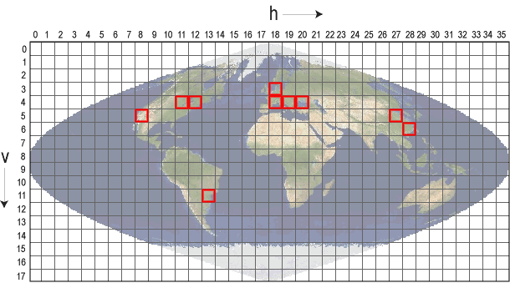
Goal: Run MODIS processing pipeline in cloud
getLandUse
x 317
analyzeLandUse
colorMODIS
assemble
markMap
MODIS script is automatically run in parallel:
Each loop level can process tens
to thousands of image files.
getLandUse
x 317
colorMODIS
x 317
analyzeLandUse
assemble
markMap
Notes:
app getlanduse
app analyzeLandUse
app colorMODIS
app assemble
app markMap

Slide 5
Solution: Swift parallel distributed scripting
Data server
Submit host (login node, laptop, Linux server)
Swift
script
Clouds:
Amazon EC2, NSF FutureGrid, Wispy, …
Nimbus, Phantom
Swift runs parallel scripts on cloud resources provisioned by Nimbus’s Phantom service.
Notes:
5
The Swift parallel scripting language lets users do this.
Test locally at small scale, then run on diverse parallel resources at large – and extreme – scales.

Slide 6
MODIS script in Swift: main data flow
foreach g,i in geos {
land[i] = getLandUse(g,1);
}
(topSelected, selectedTiles) =
analyzeLandUse(land, landType, nSelect);
foreach g, i in geos {
colorImage[i] = colorMODIS(g);
}
gridMap = markMap(topSelected);
montage =
assemble(selectedTiles,colorImage,webDir);

Slide 7
Demo of Nimbus-Phantom-Swift on FutureGrid
User provisions 5 nodes with Phantom
Phantom starts 5 VMs
Swift worker agents in VMs contact Swift coaster service to request work
Start Swift application script “MODIS”
Swift places application jobs on free workers
Workers pull input data, run app, push output data
3 nodes fail and shut down
Jobs in progress fail, Swift retries
User can add more nodes with phantom
User asks Phantom to increase node allocation to 12
Swift worker agents register, pick up new workers, runs more in parallel
Workload completes
Science results are available on output data server
Worker infrastructure is available for new workloads

Slide 8
Swift and Phantom provide fault tolerance
Phantom detects downed nodes and re-provisions
Swift can retry jobs
Up to a user specified limit
Can stop on first unrecoverable failure, or continue till no more work can be done
Very effective, since Swift can break workflow into many separate scheduler jobs, hence smaller failure units
Swift can replicate jobs
If jobs don’t complete in a designated time window, Swift can send copies of the job to other sites or systems
The first copy to succeed is used, other copies are removed
Each app() job can define “failure”
Typically non-zero return code
Wrapper scripts can decide to mask app() failures and pass back data/logs about errors instead

Slide 9
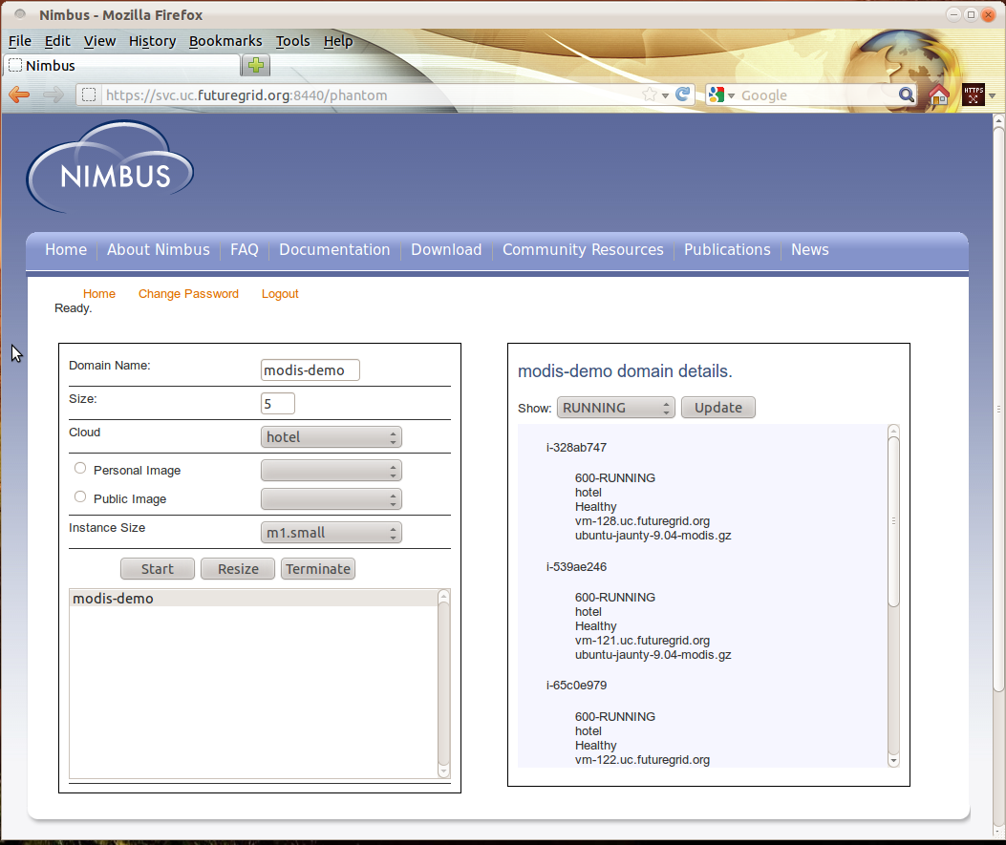
5 VMs started by Phantom on FutureGrid

Slide 10
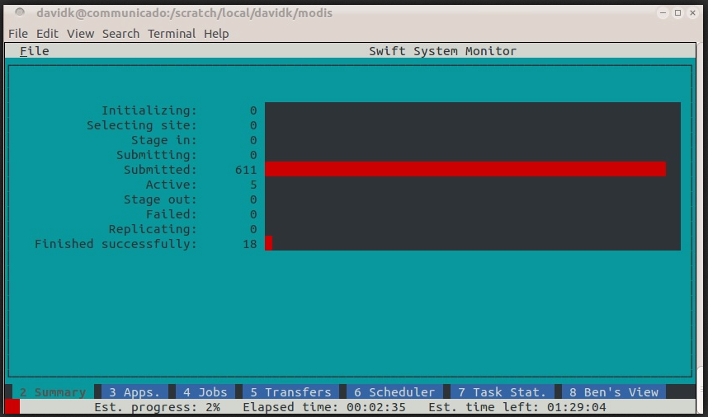
03:20

Slide 11
Phantom: 3 VMs failed “unexpectedly” ☺

Slide 12
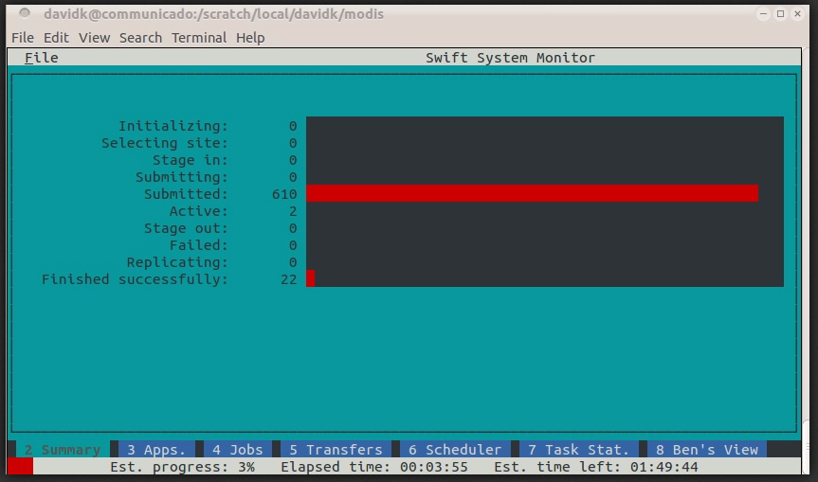
04:39: 2 jobs active after 3 VMs failed

Slide 13
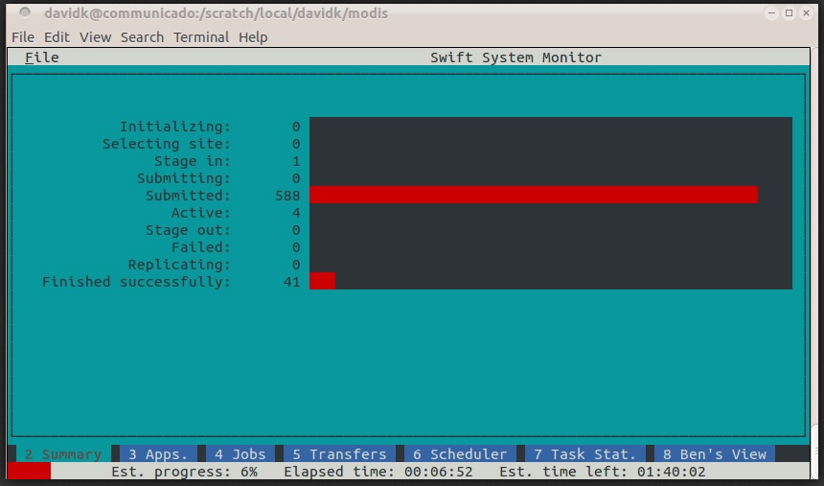
07:37 Phantom restarts failed VMs: 5 jobs active again

Slide 14
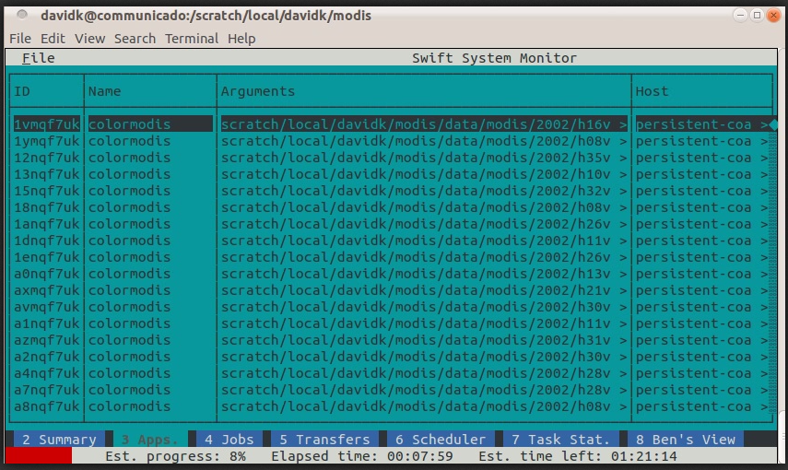
08:42 Swift application status

Slide 15
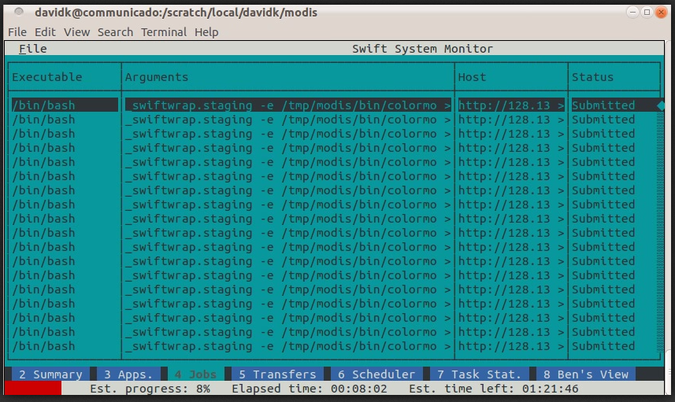
08:46 Swift job status

Slide 16
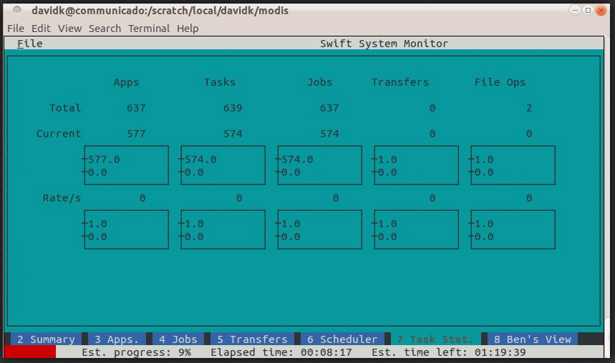
09:01 Swift status overview plot

Slide 17
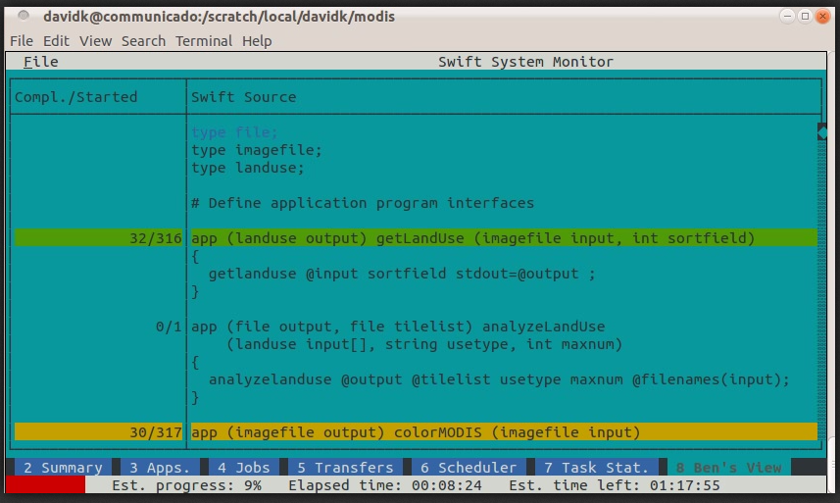
09:08 Swift status – active script lines

Slide 18
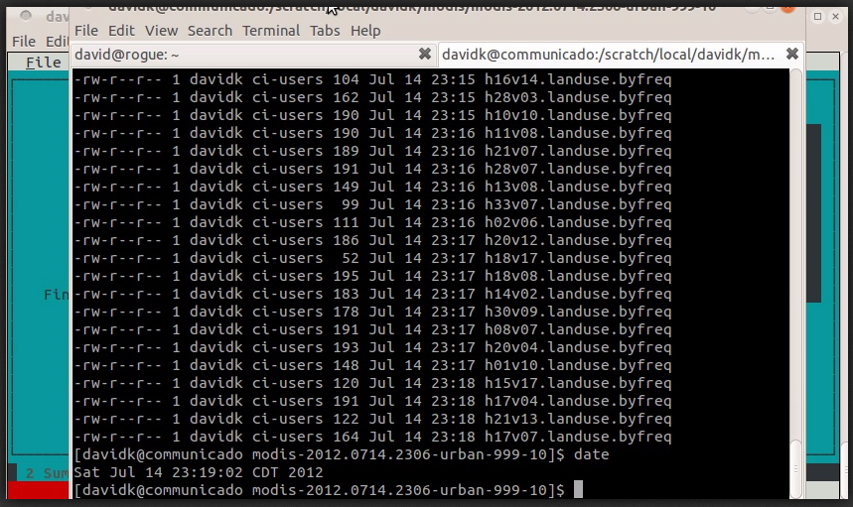
13:04 Ouput dataset: ls –l of files returned from cloud

Slide 19
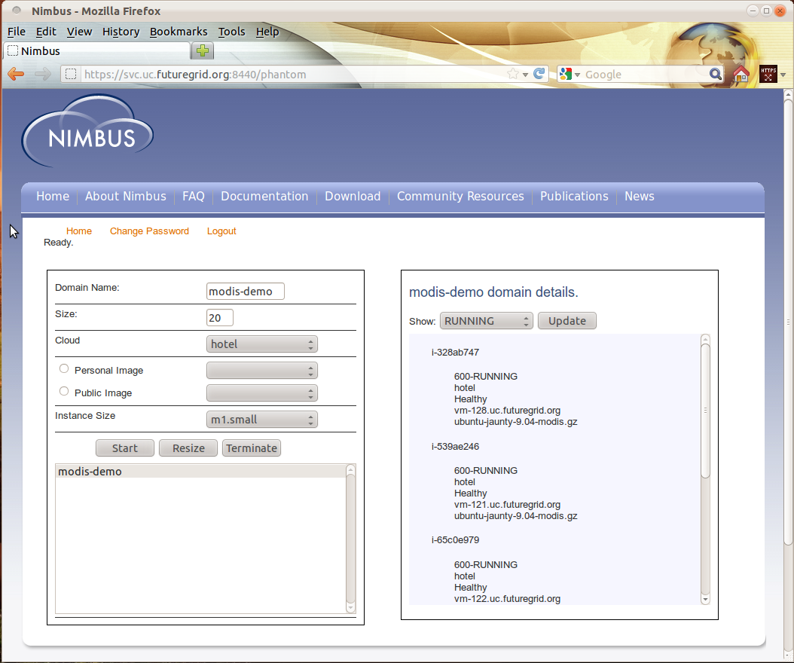
Phantom: add more resources
Notes:
This screen shot shows 20 – in the associated movie we only added 7 for a total of 12.

Slide 20
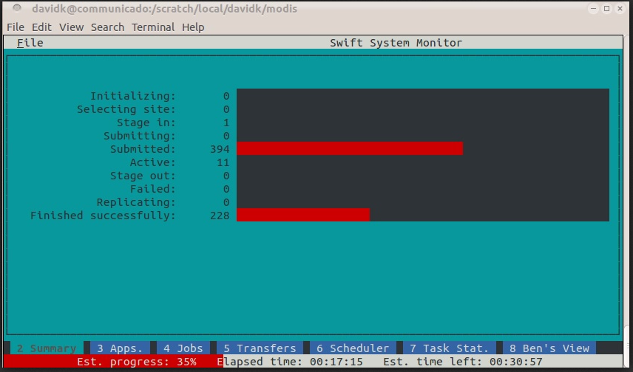
17:59 Increased resources to 12 nodes with Phantom

Slide 21
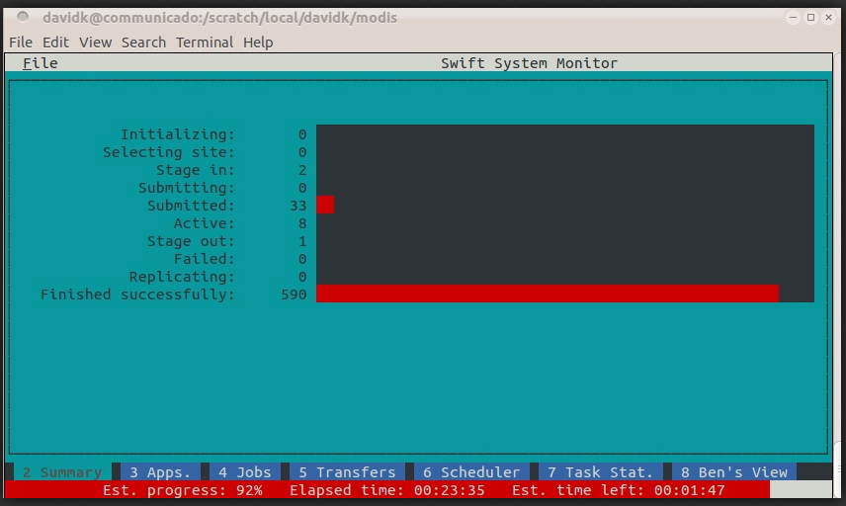
24:17 >90% completed

Slide 22
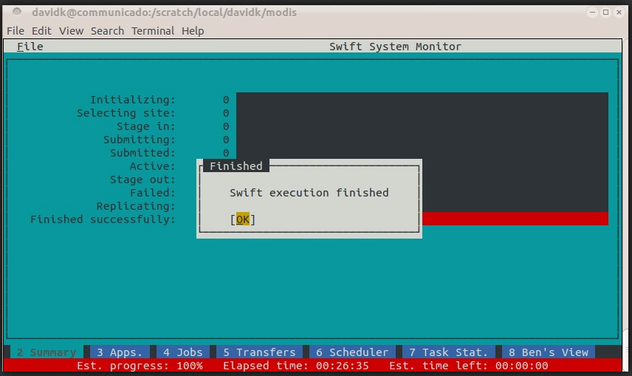
27:18 Done!

Slide 23
Supplementary slides

Slide 24
MODIS script: declare data and external science apps
type file;
type imagefile;
type landuse;
app (landuse output) getLandUse (imagefile input, int sortfield)
{ getlanduse @input sortfield stdout=@output ; }
app (file output, file tilelist) analyzeLandUse
(landuse input[], string usetype, int maxnum)
{ analyzelanduse @output @tilelist usetype maxnum @filenames(input); }
app (imagefile output) colorMODIS (imagefile input)
{ colormodis @input @output; }
app (imagefile output) assemble
(file selected, imagefile image[], string webdir)
{ assemble @output @selected @filename(image[0]) webdir; }
app (imagefile grid) markMap (file tilelist)
{ markmap @tilelist @grid; }
int nFiles = @toint(@arg("nfiles","1000"));
int nSelect = @toint(@arg("nselect","12")); ...

Slide 25
MODIS script: compute land use and max usage
imagefile geos[] <ext; exec="modis.mapper", # Input Dataset
location=MODISdir, suffix=".tif", n=nFiles >;
# Compute the land use summary of each MODIS tile
landuse land[] <structured_regexp_mapper; source=geos, match="(h..v..)",
transform=@strcat(runID,"/\\1.landuse.byfreq")>;
foreach g,i in geos {
land[i] = getLandUse(g,1);
}
# Find the top N tiles (by total area of selected landuse types)
file topSelected<"topselected.txt">;
file selectedTiles<"selectedtiles.txt">;
(topSelected, selectedTiles) = analyzeLandUse(land, landType, nSelect);
Notes:
This script shows a portion of the fMRI study post-processing script (from Dartmouth fMRIDC) called AIRSN – which performs spatial normalization for pre-processing raw fMRI data prior to analysis.
AIRSN normalizes sets of time series of 3D volumes to a standardized coordinate system and applies motion correction and Gaussian smoothing.
This is in the functional portion of a study; Anatomic data feeds into it from a prior script stage.
AIRSN uses, primarily, a suite of command line apps called AIR, "automated image registration".
This example shows how you can take a library of command line tools, wrap them as Swift functions, and express a nice concise data flow using function chaining. This replaced a much more complex shell script that obscured the actual logic and data flow.
The script was developed early on in Swift’s development history as a test case workflow composition and Swift expressiveness.
Several of the high-level functions, such as reorientRun(), operate on an array of objects (files in this case) via a foreach() loop inside those functions. (as shown in the blue insert box at the upper right).
Note that while you don’t see any declarations here to do things in parallel, this script does indeed generate a lot of parallel activity (as shown in the next slide).
This example shows how we can arbitrarily nest Swift procedures. At the “leaves” of a nested procedure call graph are “atomic procedures” – the actual executable programs of a user’s application domain. Then swift procedures nest calls to these atomics or to other “compound” procedures. Note that atomic procedures (app() invocations) are typically executed at worker nodes, while composite procedures are handled within Swift’s Karajan workflow engine.

Slide 26
MODIS script: render data to display
# Mark the top N tiles on a sinusoidal gridded map
imagefile gridMap<"markedGrid.gif">;
gridMap = markMap(topSelected);
# Create multi-color images for all tiles
imagefile colorImage[] <structured_regexp_mapper;
source=geos, match="(h..v..)",
transform="landuse/\\1.color.png">;
foreach g, i in geos {
colorImage[i] = colorMODIS(g);
}
# Assemble a montage of the top selected areas
imagefile montage <single_file_mapper; file=@strcat(runID,"/","map.png") >; # @arg
montage = assemble(selectedTiles,colorImage,webDir);
Notes:
This script shows a portion of the fMRI study post-processing script (from Dartmouth fMRIDC) called AIRSN – which performs spatial normalization for pre-processing raw fMRI data prior to analysis.
AIRSN normalizes sets of time series of 3D volumes to a standardized coordinate system and applies motion correction and Gaussian smoothing.
This is in the functional portion of a study; Anatomic data feeds into it from a prior script stage.
AIRSN uses, primarily, a suite of command line apps called AIR, "automated image registration".
This example shows how you can take a library of command line tools, wrap them as Swift functions, and express a nice concise data flow using function chaining. This replaced a much more complex shell script that obscured the actual logic and data flow.
The script was developed early on in Swift’s development history as a test case workflow composition and Swift expressiveness.
Several of the high-level functions, such as reorientRun(), operate on an array of objects (files in this case) via a foreach() loop inside those functions. (as shown in the blue insert box at the upper right).
Note that while you don’t see any declarations here to do things in parallel, this script does indeed generate a lot of parallel activity (as shown in the next slide).
This example shows how we can arbitrarily nest Swift procedures. At the “leaves” of a nested procedure call graph are “atomic procedures” – the actual executable programs of a user’s application domain. Then swift procedures nest calls to these atomics or to other “compound” procedures. Note that atomic procedures (app() invocations) are typically executed at worker nodes, while composite procedures are handled within Swift’s Karajan workflow engine.

Slide 27
Runtime to execute Swift apps in the Cloud
Data server
Cloud
resources
f1
f2
f3
Submit host (Laptop, Linux server, …)
script
Java application
App a1
App a2
Phantom provisions cloud Compute nodes
site list
app list
f1
Workflow
status
and logs
Provenance
log
a1
f2
Swift supports clusters, grids, and supercomputers. Download, untar, and run
a2
f3
Notes:
27
This slide shows how Swift programs are executed.
The “swift” command itself (in blue, at center) is a Java application. It takes as input:
-- the .swift script to run
--- a “site list” file that specifies the attributes of the execution “sites” on which Swift should execute any application programs invoked by the script
--- an “application list” that specifies where those applications are installed on each site
The swift command sends job execution requests to parallel resources.
It uses a set of drivers (called “providers”) to handle diverse remote resources, including schedulers (PBS, SGE, Condor, Cobalt) and distributed methods (Globus, SSH). It supports X.509 certificates for authrntication.
It also has providers to perform data staging to and from applications (including GridFTP, scp, ftp, http, WebDAV, and its own protocol)

Slide 28
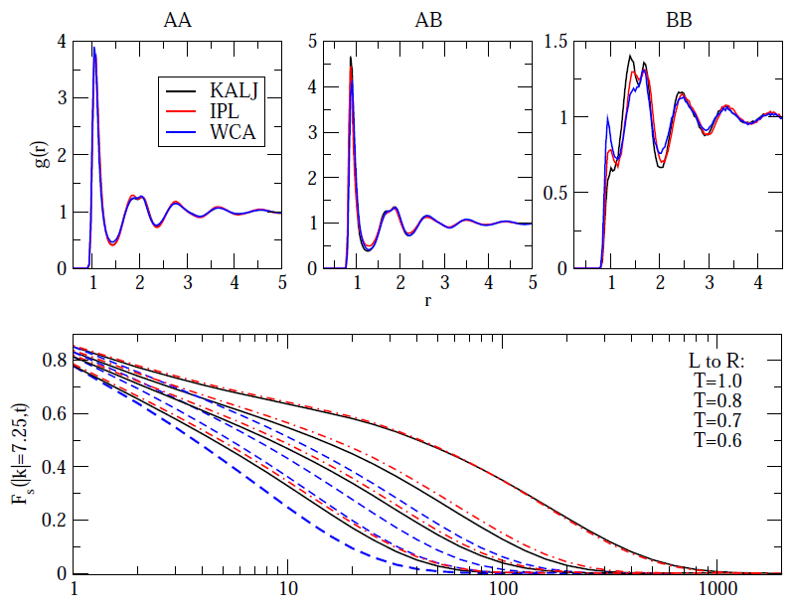
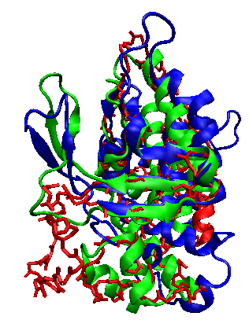
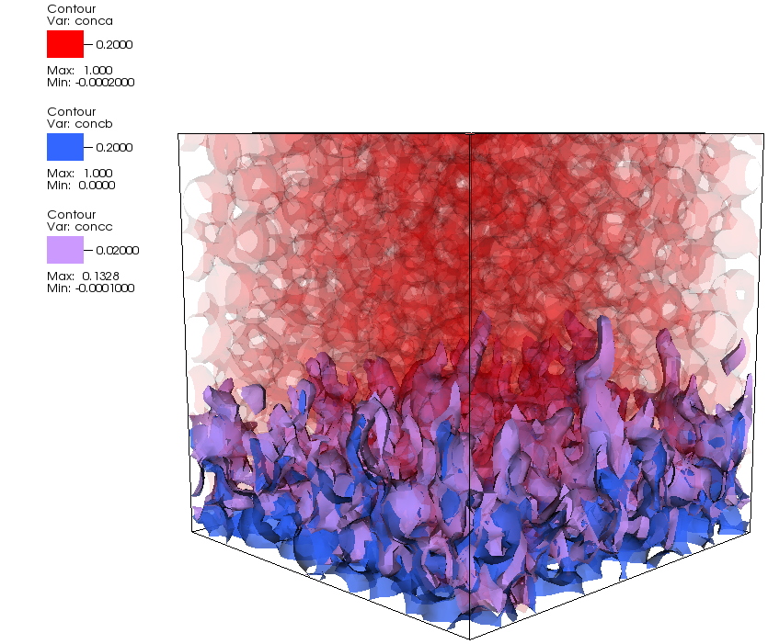
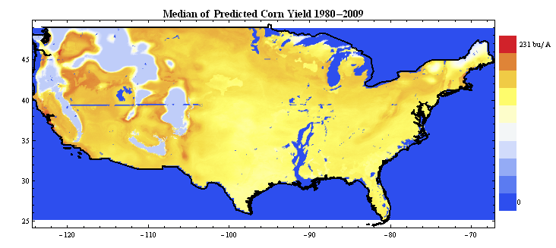
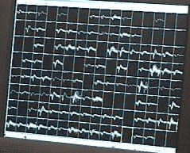
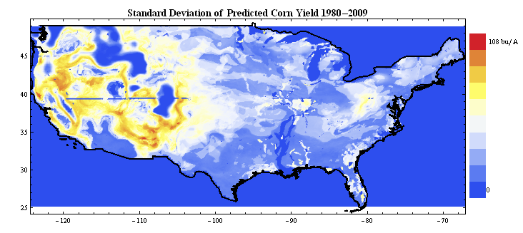
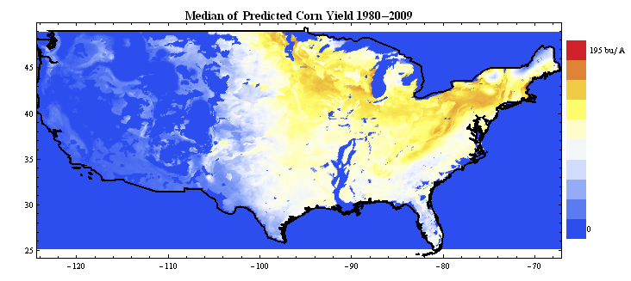
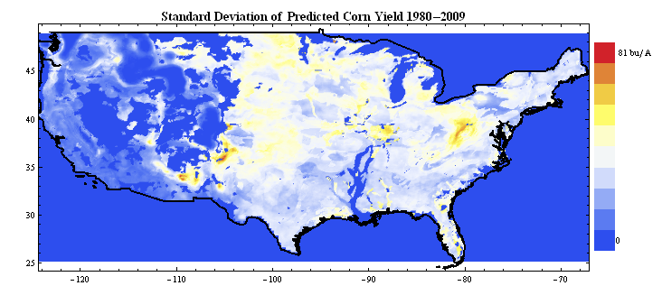
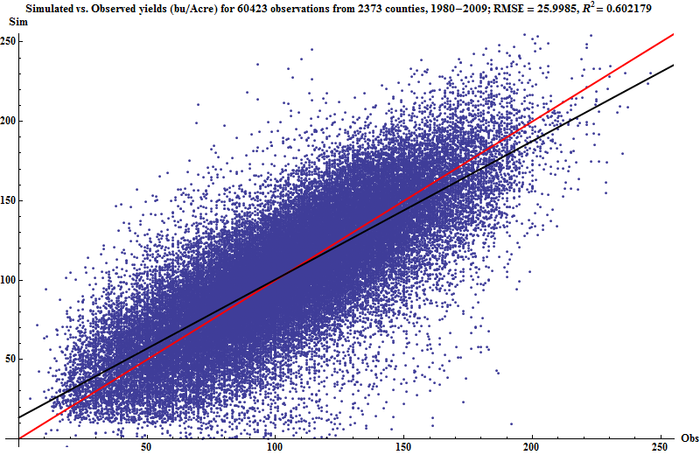
Examples of other Swift many-task applications
Simulation of super- cooled glass materials
Protein folding using homology-free approaches
Decision making in climate and energy policy
Simulation of RNA-protein interaction
Multiscale subsurface modeling on Hopper
Modeling framework for statistical analysis of neuron activation
T0623, 25 res., 8.2Å to 6.3Å (excluding tail)
A
B
C
A
B
Initial
Predicted
Native
D
E
F
E
F
Protein loop modeling. Courtesy A. Adhikari
D
C
Notes:
APP A: Simulation of super-cooled glassy materials
This project models of aspects of glass structure at a theoretical chemistry level. (Hocky/Reichman)
Recent studies of the glass transition in model systems have focused on calculating from theory or simulation what is known as the “mosaic length”. This project evaluated a new “cavity method” for measuring this length scale. Correlation functions are calculated at the interior of cavities of varying sizes and averaged over many independent simulations to determine a thermodynamic length. Using Swift on Beagle, Hocky investigated whether this thermodynamic length causes variations among seemingly identical systems. ~1M Beagle CPU hours were used.
Results: Three simple models of glassy behavior were studied. All appear the same (top, abc) but only two of which have particles relaxing at the same rate for the same temperature (top, d). This would imply that the glass structure does not dictate the dynamics. A new computational technique was used to extract a length scale on which the liquid is ordered in an otherwise undetectable way. Results (bottom) showed that using this length we can distinguish the two systems which have the same dynamics as separate from the third which has faster dynamics than the other two.
A manuscript is in preparation for Physical Review Letters.
APP B:
The laboratories of Karl Freed and Tobin Sosnick use Beagle to develop and validate methods to predict protein structure using homology-free approaches.
A. Adhikari (under K. Freed and T. Sosnick) has developed new structure prediction techniques based on Monte Carlo simulated annealing which employ novel, compact molecular representations and innovative “moves” of the protein backbone to achieve accurate prediction with far less computation then previous methods. One of the applications of the method involves rebuilding local regions in protein structures, called “loop modeling”, a problem which the group tackled with considerable success in the CASP protein folding tournament(shown in right).They are now testing further algorithmic innovations using the computational power of Beagle.
APP C – DSSAT Land use simulation
The CIM-EARTH and RDCEP projects develop large-scale integrated modeling frameworks for decision makers in climate and energy policy. (Foster, Elliott)
The Cray “Beagle” is being used to study land use, land cover, and the impacts of climate change on agriculture and the global food supply. Using a DSSAT 4.0 (“Decision Support System for Agrotechnology Transfer”) crop systems model ported from Windows, a parallel simulation framework was implemented using Swift. Benchmarks of this framework have been performed on a prototype simulation campaign, measuring yield and climate impact for a single crop (maize) across the conterminous USA with daily weather data and climate model output spanning 120 years (1981-2100) and 16 different configurations of local management (fertilizer and irrigation) and cultivar choice.
Preliminary results of parallel DSSAT on Beagle have been presented in an NSF/advisory board meeting of the CIM-EARTH project. At right, top 2 maps: Preliminary results of parallel DSSAT: maize yields across the USA with intensive nitrogen application and full irrigation; bottom 2 maps show results with no irrigation. Each model run is ~120,000 DSSAT invocations.
------ APP E (from PNNL) --------
Multiscale subsurface modeling using the STOMP application
Integrates STOMP and SPH application codes
Executes MPI, serial, and viz apps form Swift on NERSC Cray resources Franklin and Hopper
Design and Implementation of Many Parallel Task Hybrid Subsurface Model, (K Agarwal, J Chase, K Schuchardt, T Scheibe, B Palmer, T Elsethagen, PNNL, MTAGS 2011 at SC11.
---------- APP D: Simulation/prediction of protecin-RNA interaction ------------
M. Parisien (with T. Sosnick, T. Pan, and K. Freed) used Beagle to develop a first-generation algorithm for the prediction of the RNA-protein interactome.
Non-coding RNAs often function in cells through specific interactions with their protein partners. Experiments alone cannot provide a complete picture of the RNA-protein interactome. To complement experimental methods, computational approaches are highly desirable. No existing method, however, can provide genome-wide predictions of docked RNA-protein complexes.
the application of computational predictions, together with experimental methods, will provide a more complete understanding on cellular networks and function of RNPs. The approach makes use of a rigid-body docking algorithm and a scoring function custom- tailored for protein-tRNA interactions. Using Swift, Beagle screened about 300 proteins per day on 80 nodes of 24 cores (11% of the total XE6’s power).
Results: the scoring function can identify the native docking conformation in large sets of decoys (100,000) for many known protein-tRNA complexes (4TRA shown here). (left) Scores for true positive complexes (●)(N=28) are compared to true negative ones of low (▼)(N=40) and high (▲) (N=40) isoelectric points. (right) Because the density curve of the true positives, which have pI < 7, has minimal overlap with the curve of the low pI true negatives (blue area), the scoring function has the specificity to identify tRNA-binding proteins. Protein-DNA interactions are being similarly studied.
Systematic prediction and validation of RNA-protein interactome. Parisien M, Sosnick TR, Pan T. Poster; Kyoto, June 12-19, 2011, RNA Society. Manuscript in progress.
---------- App F --------
u
Uses serial MATLAB code run in parallel under Swift to perform statistical analysis of high-data-rate signals from neural activation sensors in animal studies.

Slide 29
Summary
Swift is a parallel scripting language for multicores, clusters, grids, clouds, and supercomputers
for loosely-coupled “many-task” applications – programs and tools linked by exchanging files
debug on a laptop, then run on a Cray system
Swift is easy to write
a simple high-level functional language with C-like syntax
Small Swift scripts can do large-scale work
Swift is easy to run: contains all services for running Grid workflow - in one Java application
untar and run – Swift acts as a self-contained grid or cloud client
Swift automatically runs scripts in parallel – typically without user declarations
Swift is fast: based on a powerful, efficient, scalable and flexible Java execution engine
scales readily to millions of tasks
Swift is general purpose:
applications in neuroscience, proteomics, molecular dynamics, biochemistry, economics, statistics, earth systems science, and beyond.

Slide 30
Parallel Computing, Sep 2011

Slide 31
IEEE COMPUTER, Nov 2009

Slide 32
Acknowledgments
Swift is supported in part by NSF grants OCI-1148443, OCI-721939, OCI-0944332, and PHY-636265, NIH DC08638, DOE and UChicago LDRD and SCI programs
The Swift team (including some related projects) is:
Mihael Hategan, Justin Wozniak, David Kelly, Ian Foster, Dan Katz, Mike Wilde, Tim Armstrong, Zhao Zhang

